Slide 1



Slide 2
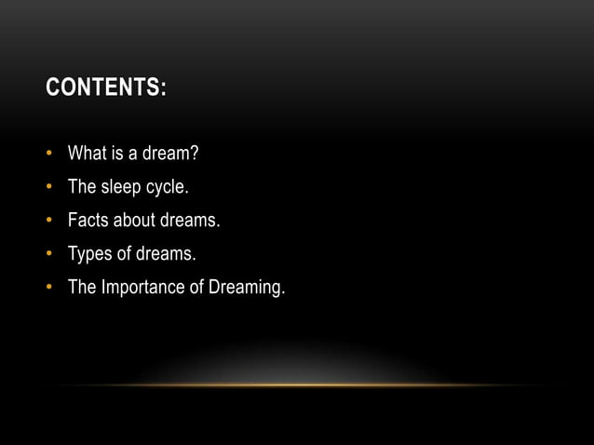

Slide 3
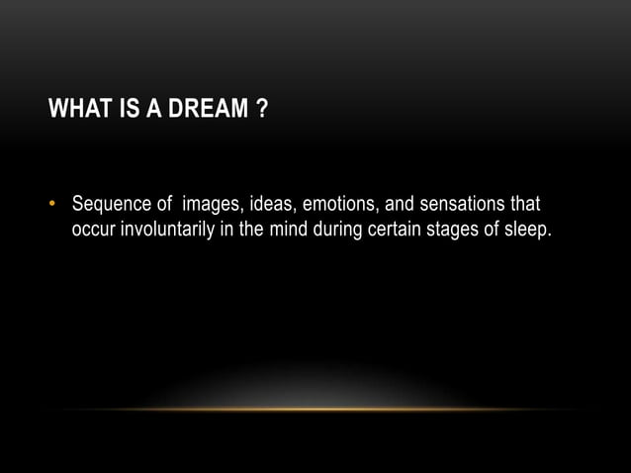

Slide 4


Slide 5


Slide 6
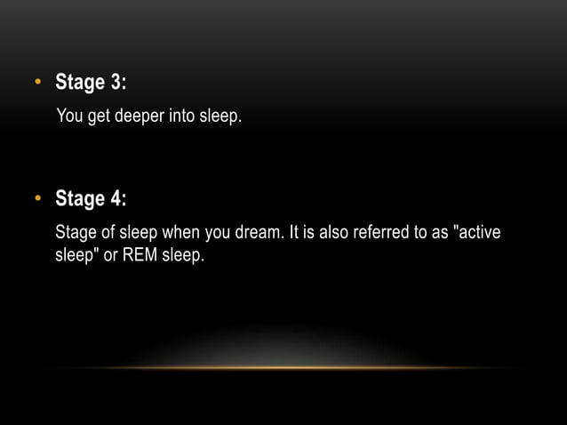

Slide 7
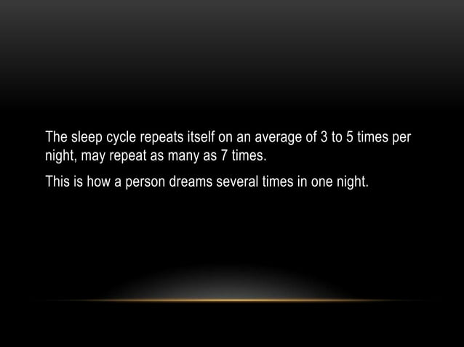

Slide 8
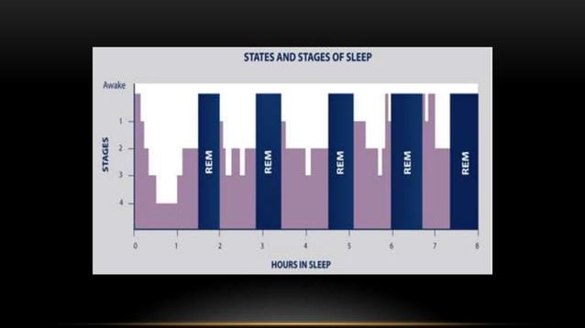

Slide 9


Slide 10


Slide 11
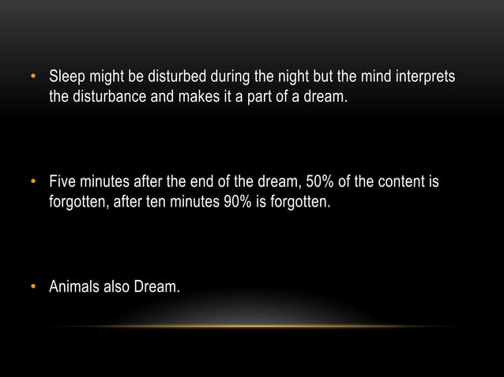

Slide 12
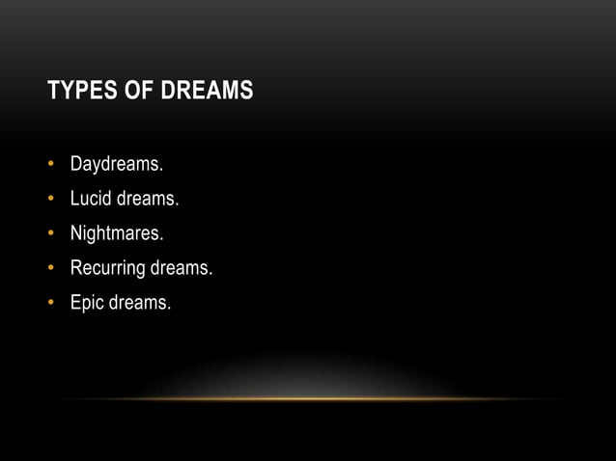

Slide 13
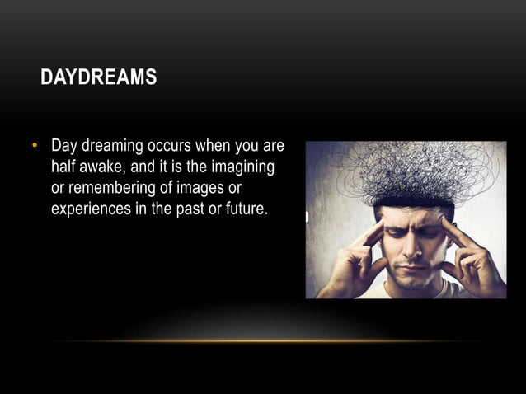

Slide 14


Slide 15


Slide 16
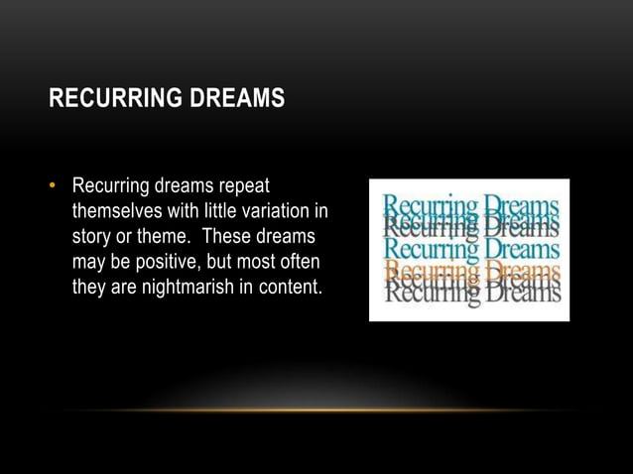

Slide 17


Slide 18
CONCLUSION
Dreams are a fascinating aspect of human experience,emerging from the intricate workings of the brain during various sleep stages. They encompass a spectrum of types, ranging from vivid, emotional scenarios to abstract, symbolic representations. While scientific understanding of dreams continues to evolve, their significance remains a subject of exploration, sparking curiosity about the mysteries of the subconscious mind.

Slide 19
THANKS
By
LAKKARAJU ANJANEYA VARA PRASAD
2320471

